Slide 1
IS 722 SYSTEMS AND INFORMATION INTEGRATION UNDER DR. GEORGE KARABATIS
TEAM 3 PROJECT DELIVERABLE
KRISHNA PATEL
SIMRAN KAUKAB SHAIK
DOREN WALKER
CHANDANA SHASHI KUMAR

Slide 2
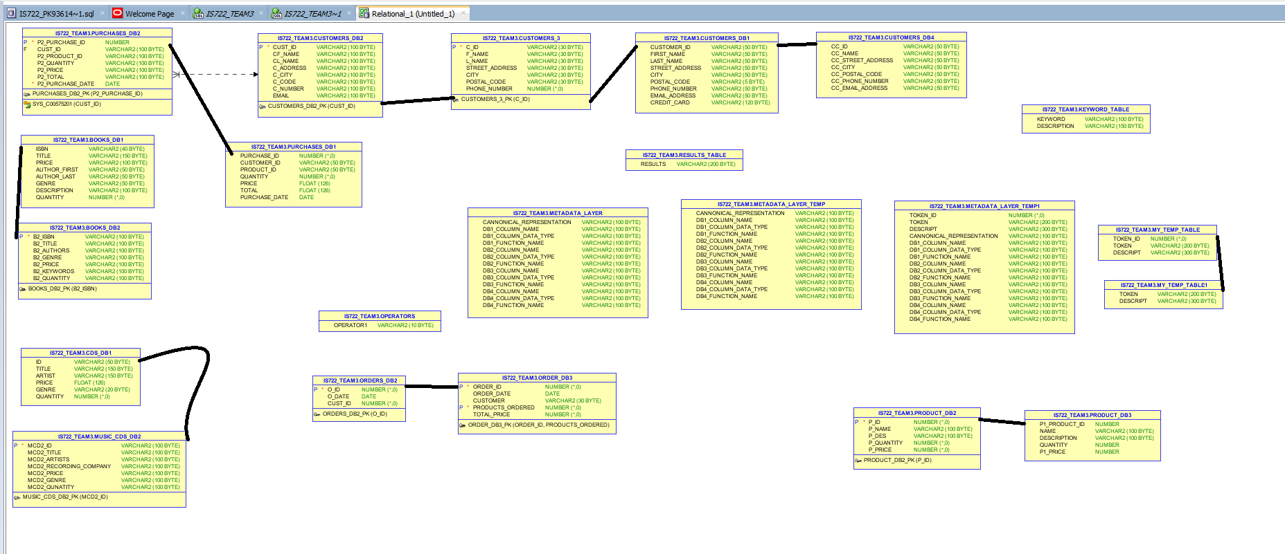
ER DIAGRAM

Slide 3
SYSTEM ARCHITECTURE OF INTEGRUM(PRODUCT)
user
Post processing
Global query verifier
Global user interface
Local access manager 3
Local access manager 4
Global query processor
Local access manager 2
Knowledge base
local access manager 1
Global query parser
Global query decomposer( Tokenizer)
Local db 2
Query evaluation supervisor
Local db 1
Loacl db 4
Local db 3

Slide 4
BRIEF INTRODUCTION ABOUT INTEGRUM ARCHITECTURE AND PROCEDURE
Keyword_table Is the keywords table (Comprehensive list of keywords found online. 81 keywords) which from a global query gets equivalent keywords puts them in the output directly without passing into tokenizer
My_temp_table creation which holds token,descript,operator,condition details
Metadata_layer_temp table creation
Tokenize the query in the string format after giving its input as the global query.; global query decomposer
Using a cursor as a lookup for token descript and inserting token descript keyword data in metadata_layer_temp table
Operators table, =,<>,!=,<=,>=, LIKE
Metadata_layer_temp1 is a replica mapping table of metadata_layer_temp for the usage in the single column query.
In the single column query,with the usage of dynamic sql have the convenience to see multiple sub queries in the results tab ,inserted the data into results_table which is the final table after integrating all the 4 subquery results of 4 local databases; post processing phase

Slide 5
ITEMS THAT DIFFERENTIATE INTEGRUM FROM CROWD OF COMPETITION
We have achieved the product dynamically that after taking the global query gives us the local database queries dynamically.
Dynamic nature can increase fully still when still worked on the post processing part given much time.

Slide 6
CONCLUSIONS
Integration between data bases local db 1,2,3,4 is achieved through canonical mapping with metadata layer usage
Performance of the system greatly improved after the integration and creation of metadata layer commonly among all the databases with the help of canonical table
Cost savings are done, Data which is valuable is collected, Visibility is enhanced in real time, Process efficiency has achieved.

Slide 7

ANY QUESTIONS?

